Slide 1
Chapter 10
Classes and Data Abstraction

Slide 2
Objectives (1 of 2)
In this chapter, you will:
Learn about classes
Learn about private, protected, and public members of a class
Explore how classes are implemented
Become aware of accessor and mutator functions
Examine constructors and destructors

Slide 3
Objectives (2 of 2)
Learn about the abstract data type (ADT)
Explore how classes are used to implement ADTs
Become aware of the differences between a struct and a class
Learn about information hiding
Explore how information hiding is implemented in C++
Become aware of inline functions of a class
Learn about the static members of a class

Slide 4
Classes (1 of 4)
Object-oriented design (OOD): a problem solving methodology
Object: combines data and the operations on that data in a single unit
Class: a collection of a fixed number of components
Member: a component of a class

Slide 5
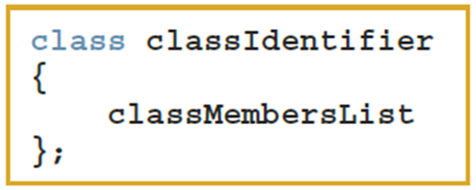
Classes (2 of 4)
The general syntax for defining a class:
A class member can be a variable or a function
If a member of a class is a variable
It is declared like any other variable
You cannot initialize a variable when you declare it

Slide 6
Classes (3 of 4)
If a member of a class is a function
A function prototype declares that member
Function members can (directly) access any member of the class
A class definition defines only a data type
No memory is allocated
Remember the semicolon (;) after the closing brace

Slide 7
Classes (4 of 4)
Three categories of class members:
private (default)
Member cannot be accessed outside the class
public
Member is accessible outside the class
Protected
Member can be accessed within the same class, as well as by derived classes, but not by other parts of the program.

Slide 8
Unified Modeling Language Class Diagrams (1 of 2)
Unified Modeling Language (UML) notation: used to graphically describe a class and its members
+: member is public
-: member is private
#: member is protected

Slide 9
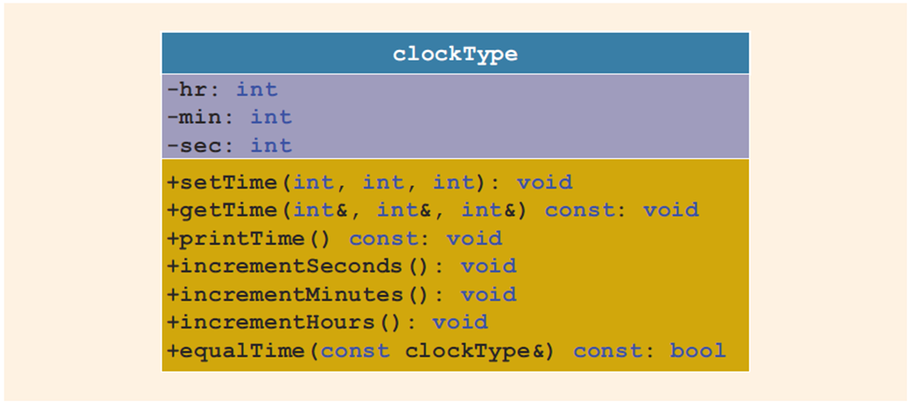
Unified Modeling Language Class Diagrams (2 of 2)
FIGURE 10-1 UML class diagram of the class clockType

Slide 10
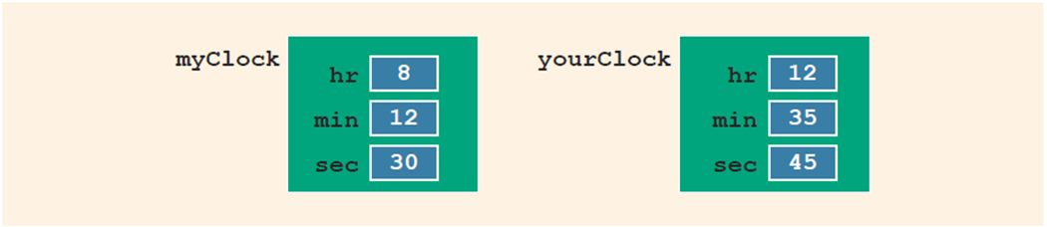
Variable (Object) Declaration
Once defined, you can declare variables of that class type
clockType myClock;
clockType yourClock;
A class variable is called a class object or class instance
FIGURE 10-2 Objects myClock and yourClock

Slide 11

Accessing Class Members
Once an object is declared, it can access the members of the class
The general syntax for an object to access a member of a class:
If an object is declared in the definition of a member function of the class, it can access the public and private members
The dot (.) is the member access operator

Slide 12
Built-in Operations on Classes
Most of C++’s built-in operations do not apply to classes
Arithmetic operators cannot be used on class objects unless the operators are overloaded
Relational operators cannot be used to compare two class objects for equality
Built-in operations that are valid for class objects:
Member access (.)
Assignment (=)

Slide 13
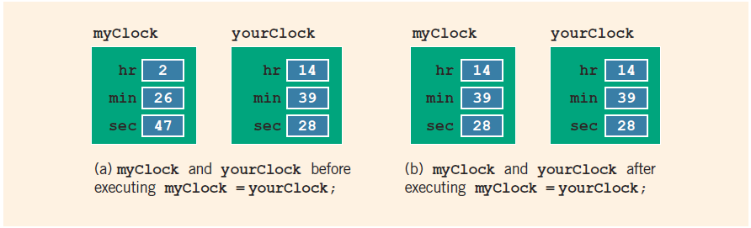
Assignment Operator and Classes
FIGURE 10-3 myClock and yourClock before and after executing the statement myClock = yourClock;

Slide 14
Class Scope (1 of 2)
A class object can be automatic or static
Automatic: created when the declaration is reached and destroyed when the surrounding block is exited
Static: created when the declaration is reached and destroyed when the program terminates
A member of a class has the same scope as a member of a struct

Slide 15
Class Scope (2 of 2)
A member of the class is local to the class
You access a class member outside the class by using the class object name and the member access operator (.)

Slide 16
Functions and Classes
Objects can be passed as parameters to functions and returned as function values
As parameters to functions:
Class objects can be passed by value or by reference
If an object is passed by value:
Contents of data members of the actual parameter are copied into the corresponding data members of the formal parameter

Slide 17
Reference Parameters and Class Objects (Variables) (1 of 2)
Passing by value might require a large amount of storage space and a considerable amount of computer time to copy the value of the actual parameter into the formal parameter
If a variable is passed by reference:
The formal parameter receives only the address of the actual parameter

Slide 18
Reference Parameters and Class Objects (Variables) (2 of 2)
Pass by reference is an efficient way to pass a variable as a parameter
Problem: when passing by reference, the actual parameter changes when the formal parameter changes
Solution: use const in the formal parameter declaration

Slide 19

Implementation of Member Functions (1 of 4)
Must write the code for functions defined as function prototypes
Prototypes are left in the class to keep the class smaller and to hide the implementation
To access identifiers local to the class, use the scope resolution operator,

Slide 20
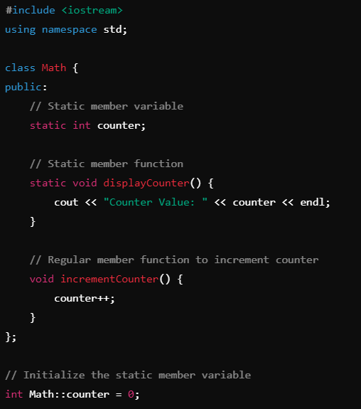

Slide 21
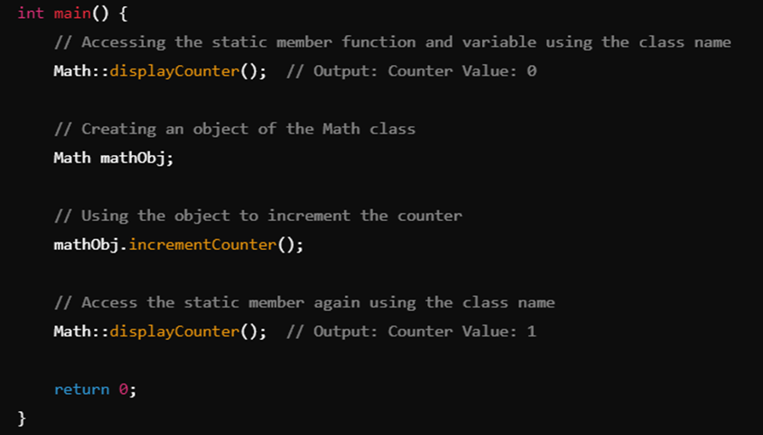

Slide 22
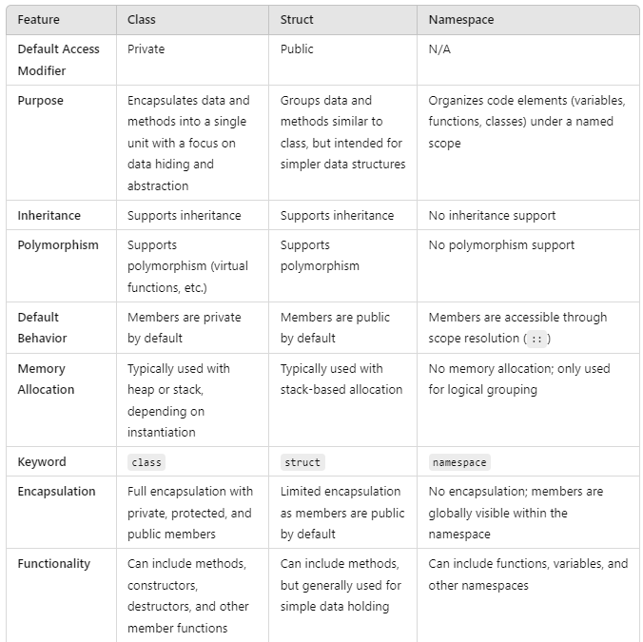
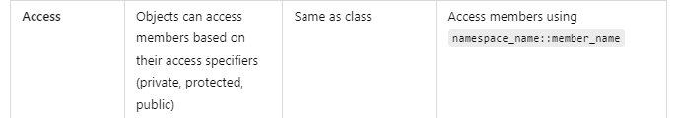

Slide 23
Class
When to use:
When you want to encapsulate data and provide controlled access (using private/protected access specifiers).
When you need inheritance and polymorphism.
When you want to implement advanced object-oriented designs with methods and data manipulation.

Slide 24
Struct
When to use:
When you want a simple data structure with public access.
When you don't need encapsulation or inheritance.
Ideal for plain data structures like mathematical objects (e.g., Point, Vector) or simple records (e.g., Person, Address).

Slide 25
Namespace
When to use:
When you want to group related code elements, such as constants, functions, or classes, to avoid name collisions.
Suitable for organizing libraries or large projects where different components might have similar names.
Helps keep global namespace clean and manageable.

Slide 26
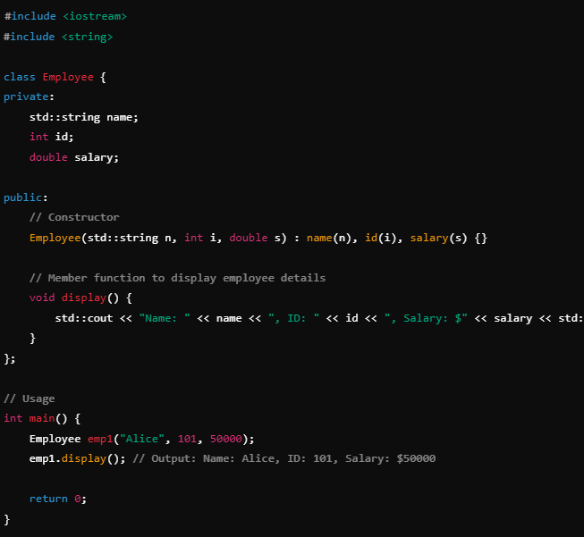

Slide 27
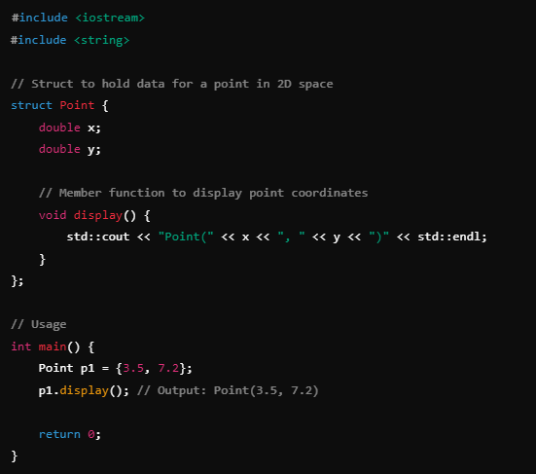

Slide 28
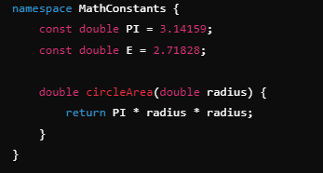

Slide 29
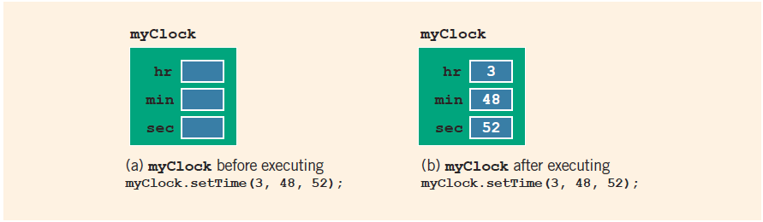
Implementation of Member Functions (2 of 4)
FIGURE 10-4 myClock before and after executing the statement myClock.setTime(3, 48, 52);

Slide 30
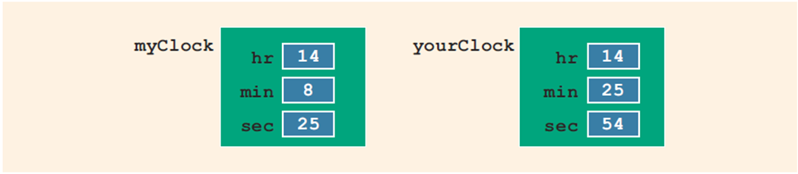
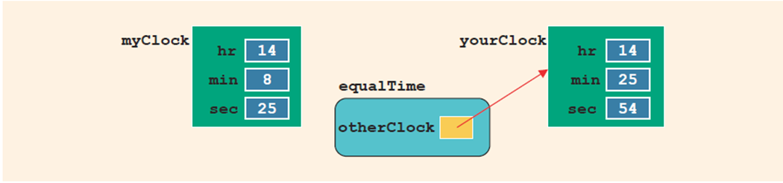
Implementation of Member Functions (3 of 4)
FIGURE 10-5 Objects myClock and yourClock
FIGURE 10-6 Object myClock and parameter otherClock

Slide 31
Implementation of Member Functions (4 of 4)
Once a class is properly defined and implemented, it can be used in a program
A program that uses/manipulates objects of a class is called a client of that class
When you declare objects of the class clockType, each object has its own copy of the member variables (hr, min, and sec)
These variables are called instance variables of the class
Every object has its own copy of the data

Slide 32
Accessor and Mutator Functions
Accessor function: member function that only accesses the value(s) of member variable(s)
Mutator function: member function that modifies the value(s) of member variable(s)
Constant member function
Member function that cannot modify member variables of that class
Member function heading with const at the end

Slide 33
Order of public and private Members of a Class
C++ has no fixed order in which to declare public and private members
By default, all members of a class are private
Use the member access specifier public to make a member available for public access

Slide 34
Constructors (1 of 2)
Use constructors to guarantee that member variables of a class are initialized
Two types of constructors
With parameters
Without parameters (default constructor)
Other properties of constructors
Name of a constructor is the same as the name of the class
A constructor has no type

Slide 35
Constructors (2 of 2)
A class can have more than one constructor
Each must have a different formal parameter list
Constructors execute automatically when a class object enters its scope
They cannot be called like other functions
Which constructor executes depends on the types of values passed to the class object when the class object is declared

Slide 36
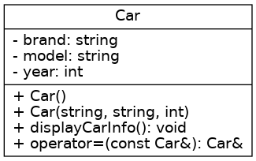
Exercise
You are tasked with building a simple car rental system that allows users to store and manage information about cars available for rent. The system should allow users to add car details, display car information, and assign car details from one car to another. This will simulate the process of moving car details between records or locations.

Slide 37
Invoking a Constructor
A constructor is automatically executed when a class variable is declared
Because a class may have more than one constructor, you can invoke a specific constructor

Slide 38

Invoking the Default Constructor
Syntax to invoke the default constructor is:
The statement:
clockType yourClock;
declares yourClock to be an object of type clockType and the default constructor executes

Slide 39
Invoking a Constructor with Parameters
The syntax to invoke a constructor with a parameter is:
Number and type of arguments should match the formal parameters (in the order given) of one of the constructors
Otherwise, C++ uses type conversion and looks for the best match
Any ambiguity causes a compile-time error

Slide 40
Constructors and Default Parameters
A constructor can have default parameters
Rules for declaring formal parameters are the same as for declaring default formal parameters in a function
Actual parameters are passed according to the same rules for functions
A default constructor is a constructor with no parameters or with all default parameters

Slide 41
Classes and Constructors: A Precaution
If a class has no constructor(s), C++ provides the default constructor
However, the object declared is still uninitialized
If a class includes constructor(s) with parameter(s), but not the default constructor
C++ does not provide the default constructor
Appropriate arguments must be included when the object is declared

Slide 42
In-line Initialization of Data Members and the Default Constructor
C++11 standard allows member initialization in class declarations
Called in-line initialization of the data members
When an object is declared without parameters, then the object is initialized with the in-line initialized values
If declared with parameters, then the default values are overridden by the constructor with the parameters

Slide 43
Arrays of Class Objects (Variables) and Constructors
If you declare an array of class objects, the class should have the default constructor
The default constructor is typically used to initialize each (array) class object

Slide 44
Destructors
Destructors are functions without any type
A class can have only one destructor
The destructor has no parameters
The name of a destructor is the tilde character (~) followed by the class name
Example: ~clockType();
The destructor automatically executes when the class object goes out of scope or deleted

Slide 45
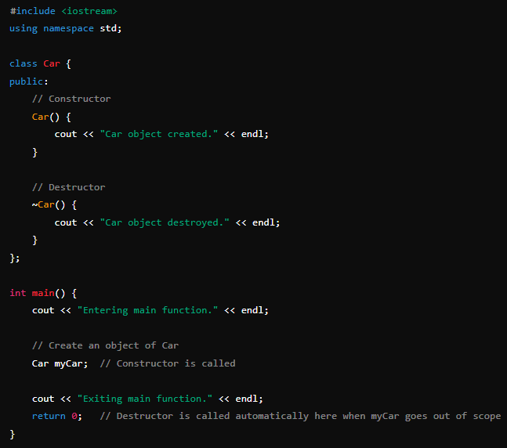

Slide 46
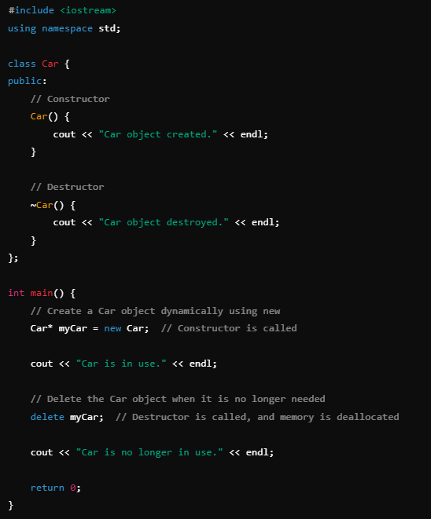
Without the user-defined destructor, the program would have a memory leak because the default destructor does not handle deallocating dynamic memory.

Slide 47
Data Abstract, Classes, and Abstract Data Types
Abstraction
Separating design details from usage
Separating the logical properties from the implementation details
Abstraction also applicable to data
Abstract data type (ADT): a data type that separates the logical properties from the implementation details
Three things associated with an ADT
Type name: the name of the ADT
Domain: the set of values belonging to the ADT
Set of operations on the data

Slide 48
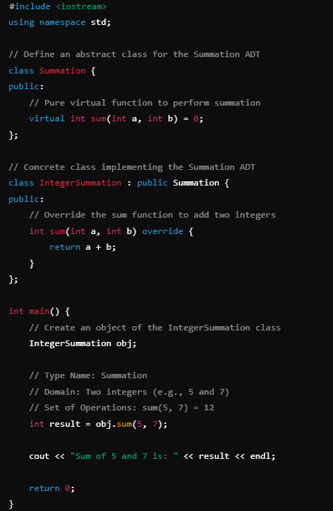
Example of ADT
Type Name: The name of this ADT is Summation.
Domain: The domain for this ADT is the set of pairs of integers.
Set of Operations: The operation defined here is sum(int, int)

Slide 49
A struct versus a class (1 of 2)
By default, members of a struct are public
private specifier can be used in a struct to make a member private
By default, the members of a class are private
classes and structs have the same capabilities

Slide 50
A struct versus a class (2 of 2)
In C++, the definition of a struct was expanded to include member functions, constructors, and destructors
If all member variables of a class are public and there are no member functions:
Use a struct

Slide 51
Information Hiding (1 of 3)
Information hiding refers to hiding the details of the operations on the data
The header file (or interface file) contains the specification details
The header file has an extension h
The implementation file contains the definitions of the functions to implement the operations of an object
This file has an extension cpp
In the header file, include function prototypes and comments that briefly describe the functions
Specify preconditions and/or postconditions

Slide 52
Information Hiding (2 of 3)
Implementation file must include the header file via the include statement
In the include statement:
User-defined header files are enclosed in double quotes
System-provided header files are enclosed between angular brackets

Slide 53
Information Hiding (3 of 3)
Precondition: a statement specifying the condition(s) that must be true before the function is called
Postcondition: a statement specifying what is true after the function call is completed

Slide 54
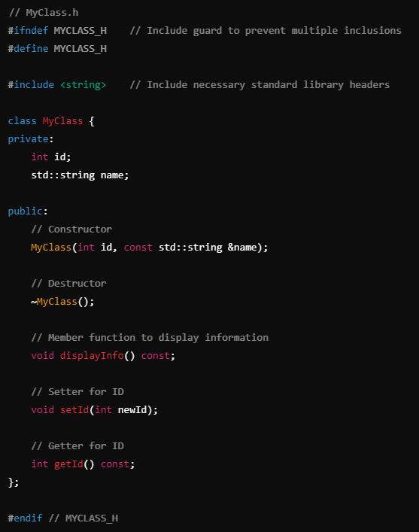
Ifndef – if not defined

Slide 55
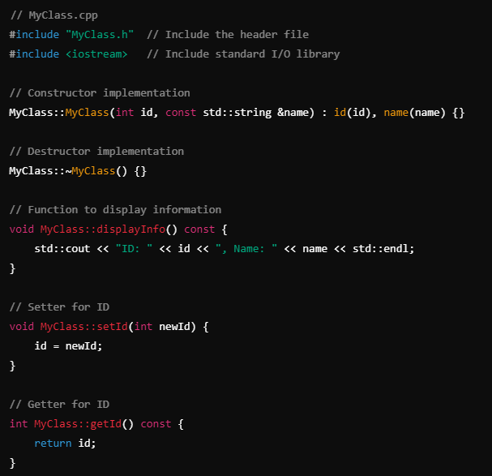

Slide 56
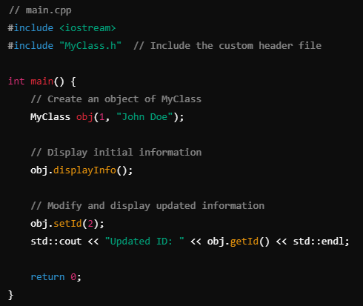
Main function

Slide 57
Executable Code
To use an object in a program
The program must be able to access the implementation details of the object
IDEs Visual C++ Express (2013 or 2016) and Visual Studio 2015, and C++ Builder put the editor, compiler, and linker into a package
One command (build, rebuild, or make) compiles program and links it with the other necessary files
These systems also manage multiple file programs in the form of a project

Slide 58
More Examples of Classes
Various examples of classes and how to use them in a program are presented
Refer to Example 10-8 through Example 10-11

Slide 59
Inline Functions
An inline function definition is a member function definition given completely in the definition of the class
Saves the overhead of a function invocation (executing a function)
the process of calling a function and providing it with the required parameters to execute its actions and return a value
Very short definitions should be defined as inline functions
The inline keyword is a suggestion, not a command. Modern compilers analyze functions to decide whether inlining will be beneficial, regardless of the inline keyword.

Slide 60
Inline Functions
No Stack Frame (aka. activation record) Setup:
Since there's no actual function call, the program doesn't need to create a new stack frame. The local variables of the function become local variables at the point of inlining or are optimized away if possible.
No Parameter Passing:
Parameters become local variables or are replaced directly with the arguments if possible. There's no need to copy arguments to a new stack frame or registers.
No Return Address Storage:
There's no need to save and restore the return address because the flow of control doesn't transfer to a separate function.
Elimination of Control Transfer Overhead:
The jump to and from the function code is eliminated, saving time and avoiding potential pipeline stalls in the CPU.
Potential for Further Optimization:
With the function code available at the call site, the compiler can perform additional optimizations, such as constant propagation, dead code elimination, and loop unrolling.

Slide 61
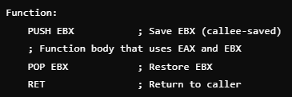
Inline Functions
A stack frame holds all the information necessary for the execution of a single function call. The typical contents of a stack frame include:
Return Address
Function Parameters
Local Variables
Saved Registers
Stores the values of certain CPU registers that the function may alter, ensuring the caller's state is preserved.
eax - accumulator. Very general purpose. Used for math, data, and function return values.
ebx - base address (within ds - data segment).
Frame Pointer (Base Pointer)
Acts as a reference point within the stack frame, making it easier to access parameters and local variables.
Control Information
May include data for exception handling or other control mechanisms.

Slide 62
Potential Issues with Stack Frames
Stack Overflow:
If too many stack frames are created (e.g., deep recursion without a base case), the call stack can exceed its memory limit, causing a stack overflow error.
Performance Overhead:
Creating and destroying stack frames takes time and resources.
This overhead can be significant for small, frequently called functions.

Slide 63
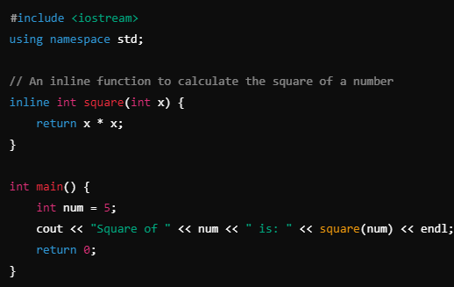

Slide 64
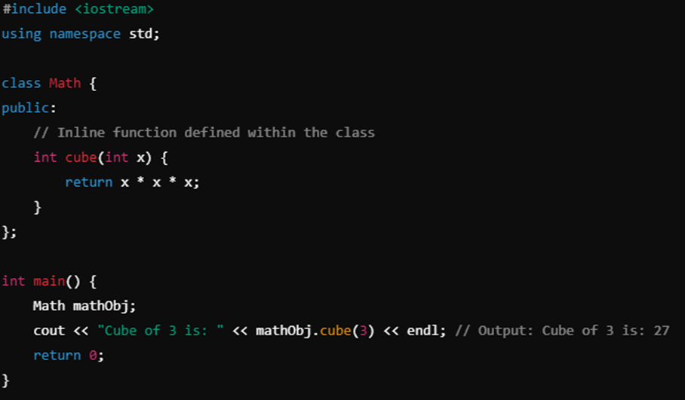

Slide 65
static Members of a Class (1 of 2)
Use the keyword static to declare a function or variable of a class as static
A public static function or member of a class can be accessed using the class name and the scope resolution operator
static member variables of a class exist even if no object of that class type exists
A static member (function or variable) belongs to the class itself, rather than to any particular object of the class. This means that static members are shared among all instances of the class.

Slide 68
static Members of a Class (2 of 2)
Multiple objects of a class each have their own copy of non-static member variables
All objects of a class share any static member of the class

Slide 69
Quick Review (1 of 3)
A class is a collection of a fixed number of components
Components of a class are called the members of the class
Accessed by name
Classified into one of three categories: private, protected, and public
In C++, class variables are called class objects or class instances or, simply, objects

Slide 70
Quick Review (2 of 3)
The only built-in operations on classes are assignment and member selection
Constructors guarantee that data members are initialized when an object is declared
A default constructor has no parameters
The destructor automatically executes when a class object goes out of scope
A class can have only one destructor
The destructor has no parameters

Slide 71

Quick Review (3 of 3)
An abstract data type (ADT) is a data type that separates the logical properties from the implementation details
A public static member, function or data, of a class can be accessed
using the class name and the scope resolution operator,
static member variables of a class exist even when no object of the class type exists
Instance variables are non-static data members

